Slide 1
Dino Runner Remastered
Name: Abhishrent Khatri
GitHub Username: Abhishrent
EdX Username: Abhishrent Khatri
City: Bhaktapur
Country: Nepal
Date: August 17, 2024

Slide 2
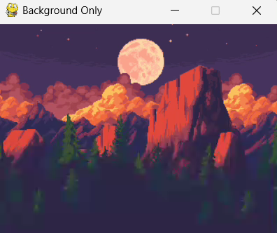
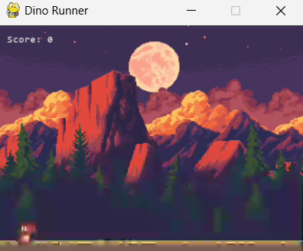
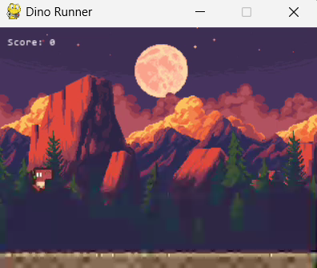
Different Testing Phases of the Game
Parallax Background
Pause Functionality
Dynamic Speed Increase Based on Score

Slide 3
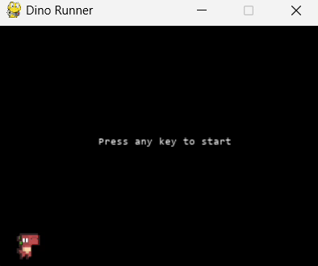
The Final Game

